Slide 1
COMP1003 – Algorithms, Data Structures & Maths
Session 06
Trigonometry
Thomas Wennekers
University of Plymouth

Slide 2
Overview
Cartesian and Polar Coordinates
Right-angled Triangles and Trigonometry
Law of Pythagoras
Sine, Cosine and Tangent functions
General Triangles, sine and cosine laws

Slide 3
1. Co-ordinate systems
Many systems need to contain information about space (and time), for example
  Computer games
  Robotics and AI systems
  Manufacturing systems
  Geographic Information Systems
In the remaining lectures we’ll take an initial look at how position and movement in space can be handled
  we’ll stick to 2 dimensions

Slide 4
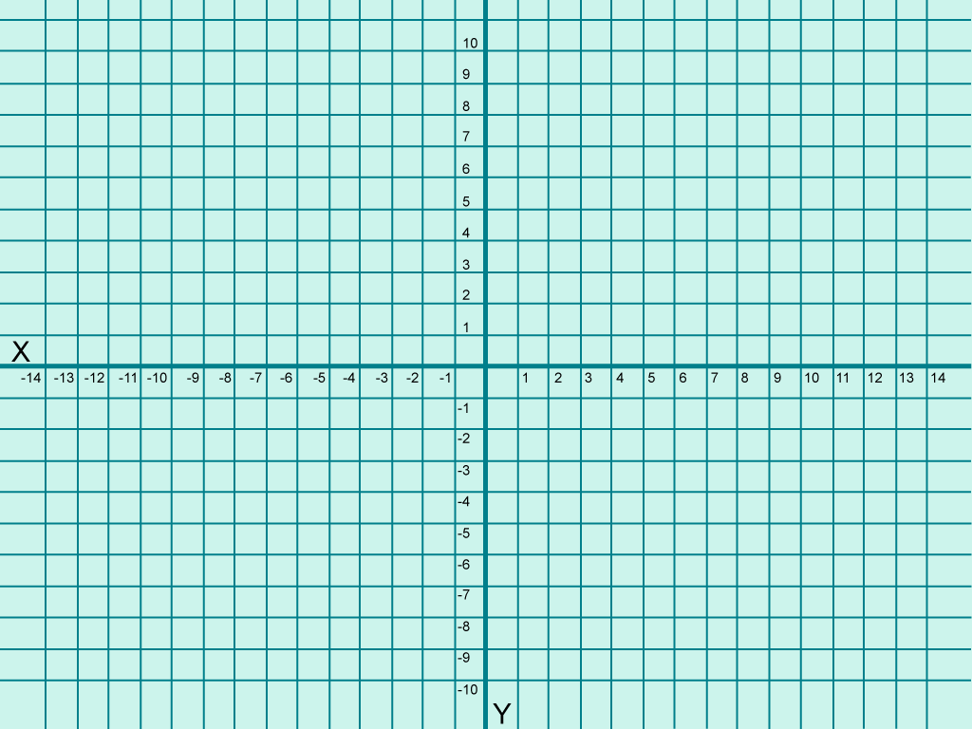
The X-Y, 2-dimensional plane

Slide 5
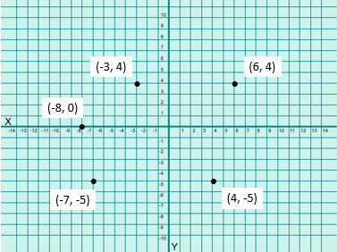
Cartesian co-ordinates of a point are represented by an (X, Y) pair

Slide 6
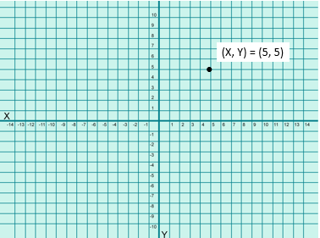
Polar co-ordinates
Polar co-ordinates specify a point by its distance r from the origin, and its angle θ (anti-clockwise) from the X-axis.
Consider the point whose cartesian co-ordinates are (5, 5).

Slide 7
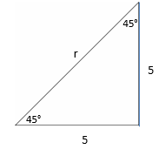
Polar co-ordinates
The distance from the origin is given by Pythagoras’ theorem
r = √(5² + 5²) = √50 ≈ 7.07
and in this case the angle is clearly 45°
Within any triangle the angles must add up to 180°. If the triangle is right-angled, then the two remaining angles must add up to 90°.
In the case on the left, the two smaller angles must be the same by symmetry – and therefore both must equal 45°.

Slide 8
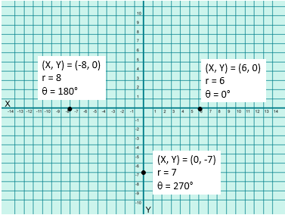
Polar Coordinates

Slide 9
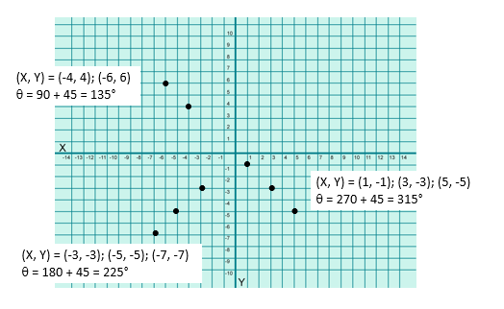
Polar Coordinates

Slide 10

Cartesian vs Polar Coordinates
Cartesian (X, Y) | Polar (r, θ)
(1, 0) | (1, 0)
(1, 1) | (√2, 45°)
(0, 1) | (1, 90°)
(-1, 1) | (√2, 135°)
(-1, 0) | (1, 180°)
(-1, -1) | (√2, 225°)
(0, -1) | (1, 270°)
(1, -1) | (√2, 315°)

Slide 11
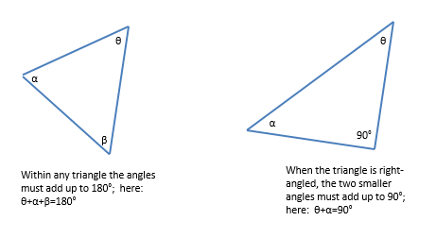
Right-angled triangles and trigonometry

Slide 12
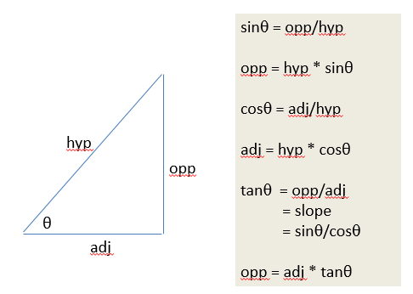
Right-angled triangles sine, cosine and tangent

Slide 13
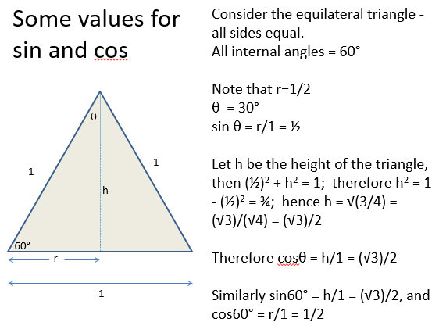

Slide 14
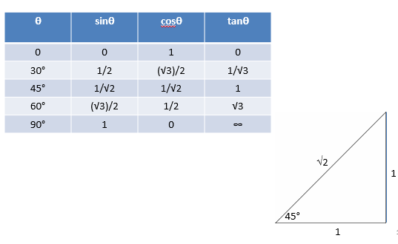
Some Well-known Values

Slide 15
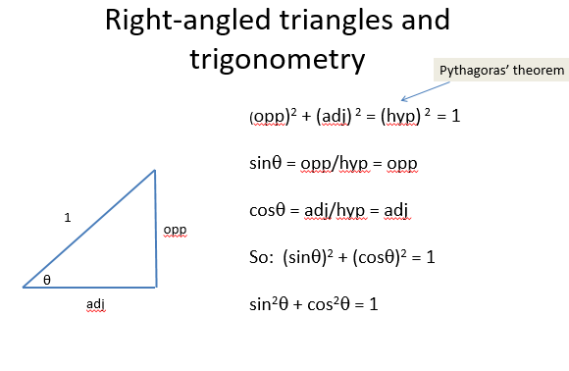

Slide 16
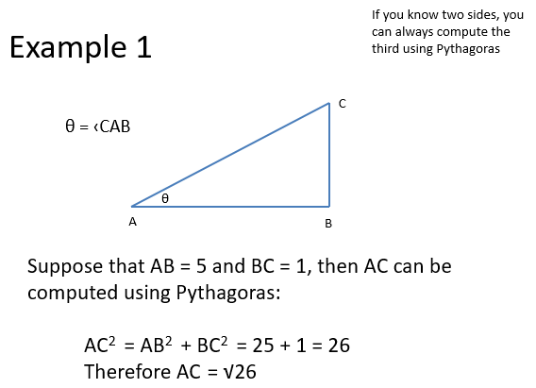

Slide 17
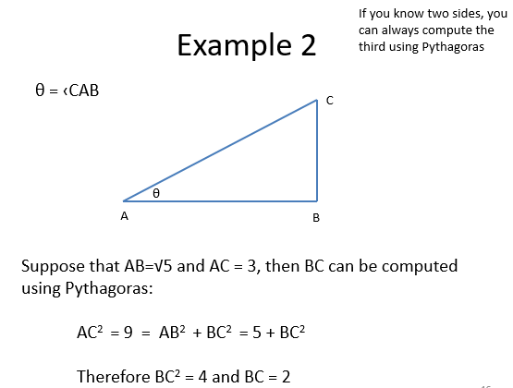

Slide 18
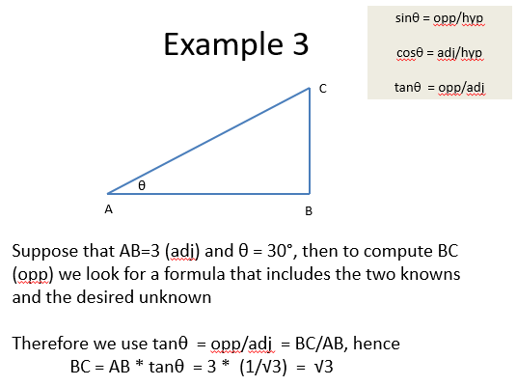

Slide 19
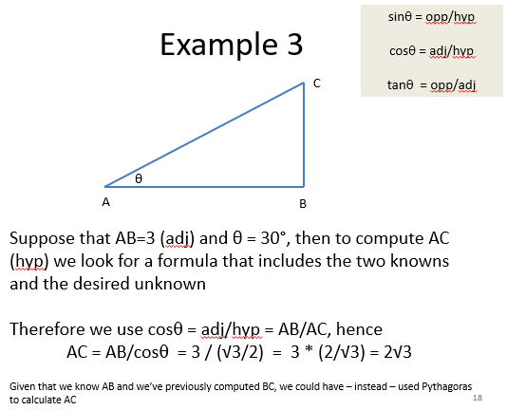

Slide 20
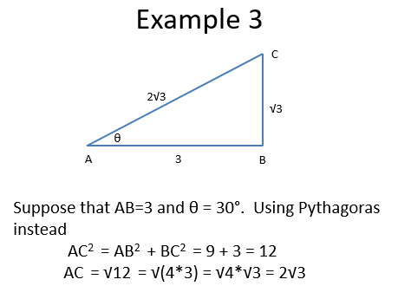

Slide 21
Angles and Radians
Using degrees: 1 full-circle = 360°
  … this goes back to the days of sea-faring when people thought a year had 360 days …
In radians a full-circle = 2π, so for example a right angle (90°) = π/2 radians

Slide 22
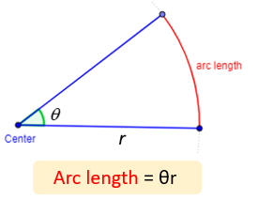

Radians and Geometry
Geometry (from the Ancient Greek: γεωμετρία; geo- "earth", -metron "measurement")
Ancient part of Maths concerned with space, things and their shape, size, position, etc.
If the angle θ is measured in radians, then the arc length s = θr

Slide 23
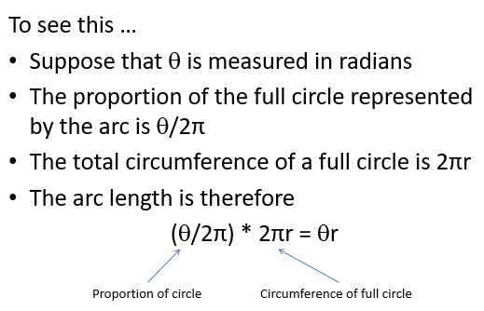
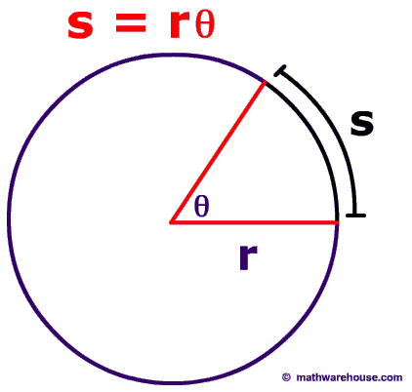
Radians and Arc Length

Slide 24
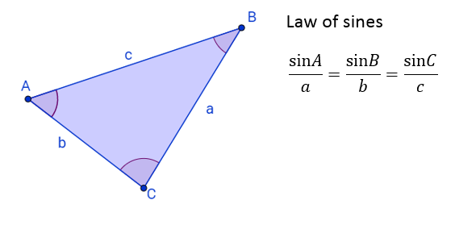

General Triangles
(ie not rectangular or otherwise special)
also:

Slide 25
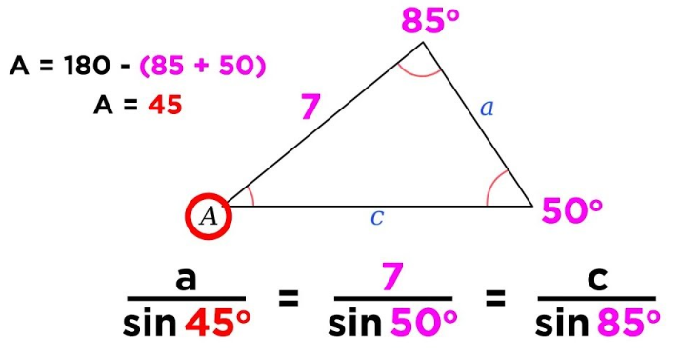
Example: Law of Sines
→ a = 7 * sin45 / sin50 ~ 6.46

Slide 26
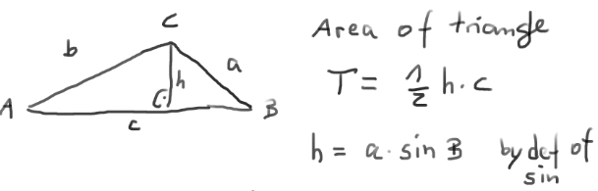
Law of Sines Proof

Slide 27
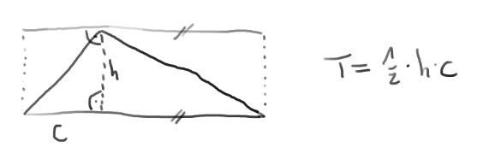
Law of Sines Proof

Slide 28
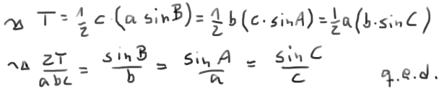
Law of Sines Proof

Slide 29
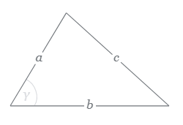

Law of Cosines
(generalises Pythagoras))

Slide 30
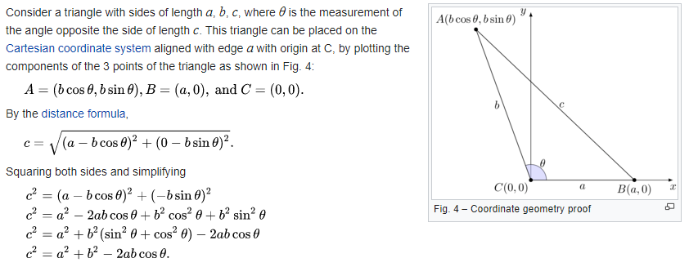
Law of Cosines Proof
Using Euclidean distance between A & B = length(c)

Slide 31
Summary
Coordinate Systems to describe Space
Sine, Cosine, Tangent Functions
Triangle Calculations and Laws
  Sine, Cosine etc definitions sin A = a/c
  Pythagoras (90deg) a² + b² = c²
  Law of Sines a/sin A = b/sin B
  Law of Cosines c² = a²+b² – 2ab cos C

